Slide 1
RE-ACCREDITATION OF HIGHER EDUCATION INSTITUTIONS IN CROATIA
Vesna Dodiković-Jurković, Ph.D.
May 2013

Slide 2
Overview
The context of Higher Education & Science
in Croatia
ASHE
Re-accreditation
Challenges

Slide 3
Map of Croatia

Slide 4
The Context of Higher Education & Science
The main stakeholders:
MSES - Ministry of Science, Education and Sports
NCHE - National Council for Higher Education
NCS - National Council for Science
ASHE - Agency for Science and Higher Education
SU - Students’ Union
Rectors’ Conference
The Croatian Council of Universities and University Colleges of Applied Sciences
HEIs
Scientific organizations

Slide 5
The Context of Higher Education & Science
Number of HEIs:
- 119 (88 public / 31 private)
10 universities (7 public / 3 private)
15 polytechnics / 27 colleges
Number of students: approx. 180 000
Number of scientific organizations: 168
(25 public scientific institutes)

Slide 6
Scheme of study programmes in Croatia
Postgraduate university
(dr.sc.,dr.art/PhD)., 3 years
ECTS number regulated by university
8.
Postgraduate professional
(uni. spec.), 1-2 years
7.
6.
Graduate
(mag. struke/Master), 1-2 years
60-120 ECTS
5.
Specialist graduate professional
(professional spec.), 1-2 years
60-120 ECTS
4.
3.
Undergraduate professional
(professional baccalareus/baccalaurea)
3-4 years
180-240 ECTS bodova
(pristupnik/associate degree)
<3 god.
<180 ECTS
Min. 300 ECTS
Undergraduate
(univ.bacc), 3-4 years
180-240 ECTS
2.
1.
UNIVERSITY STUDY PROG.
YEAR
PROFESSIONAL STUDY PROG.
UNIVERSITIES
INSTITUTION
POLYTECHNICS & COLLEGES

Slide 7
Croatian Qualification Framework
Levels
8 | 8.2.
 | 8.1.
7
6
5
4 | 4.2.
 | 4.1.
3
2
1
Types of programs
Postgraduate university study – PhD
Former Master’s Degree – 2 years
Postgraduate professional study
Graduate university study | Graduate professional study
Undergraduate university study | Undergraduate professional study
Professional study – less than 3 years Training programs – training and additional education
Secondary education – 4 years + State Matura
Secondary education – 3 years + final exam
Secondary vocational education – 1-2 years
Vocational training
Primary school (8 years)

Slide 8
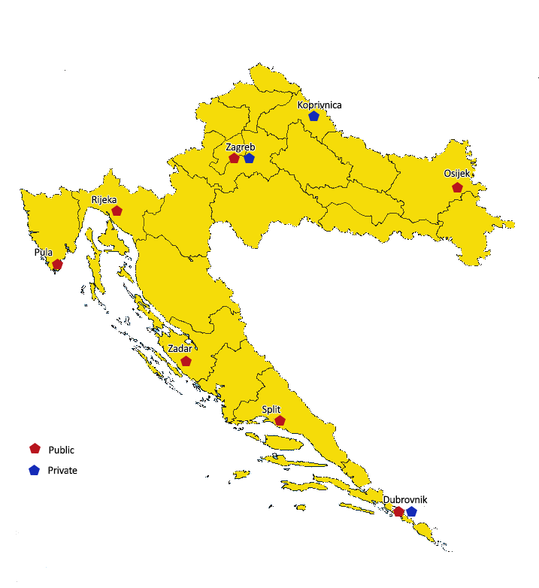
Universities - 10

Slide 9
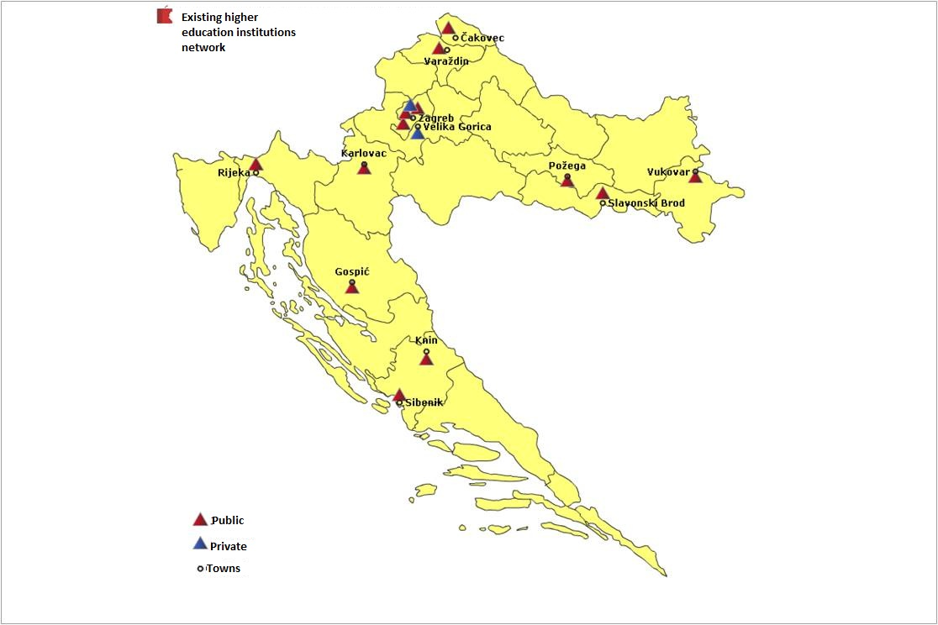
Polytechnics - 15

Slide 10
Colleges - 25

Slide 11
Type of study programmes
Type of study programmes
Professional study programmes | 215
University study programmes | 1122

Slide 12
Professional study programmes

Slide 13
University study programmes

Slide 14
The beginnings – 1990s
HE system inherited from Yugoslavia
First legislative changes in 1993 – establishment of private HEIs enabled
National Councils (Science and HE) set up – strategic and external QA role

Slide 15
Introduction of Bologna system in Croatia
2001 Croatia signed the Bologna Declaration
Impetus - wish to improve the education structure of the population, reform the system, and join the EU
Mayor changes: binary system, three cycle system, ECTS
National Councils tasked with external QA
2005 – first Bologna generation of students enrolled

Slide 16
Agency for Science and Higher Education - ASHE
Established in 2005
2009 – redefinition of its role (Quality Assurance Act) and strengthening of its independence
Is a legal entity that autonomously and independently performs activities defined by Scientific Activity and Higher Education Act, Act on Recognition of Foreign Educational Qualifications and Act on Quality Assurance in Science and Higher Education
Unifies various activities related to the science and higher education system

Slide 17
Organizational structure

Slide 18
Activities
Quality Assurance Role
2. Collecting and analysing data on the systems of science and higher education
3. National ENIC/NARIC office
4. Central Applications Office
5. Support to work of various bodies
6. International cooperation

Slide 19
QA role
Initial accreditation
Re-accreditation
Thematic evaluation
Audit

Slide 20
Initial accreditation
New HEIs and/or new study programs
New scientific organizations established and/or financed by state
Fulfilment of minimum criteria is checked

Slide 21
Re-accreditation
5–year cycles
All public and private HEIs by 2015/2016
All scientific organizations established and/or financed by the state by 2015/2016

Slide 22
Re-accreditation of HEIs
All HEIs by 2015/2016
2010/2011: re-accreditation of 20 HEIs in the field of economics and business
2011/2012: re-accreditation of 32 HEIs in the technical sciences
2012/2013: re-accreditation of 9 HEIs in the biotechnical sciences + 14 private HEIs

Slide 23
PROCEDURE
Self-assessment
Site visit
Writing report
Follow-up

Slide 24
Re-accreditation
Periodic external review
Standards and criteria (key areas)
Accreditation Commissions/Councils
Self-review
Trainings
Peer-reviews
Site-visit
Report
Follow-up
Accreditation decision
Outcome of accreditation

Slide 25
Re-accreditation - Expert Panel
ASHE coordinator +
ASHE translator
Student
International Expert
National Expert
International Expert
National Expert

Slide 26
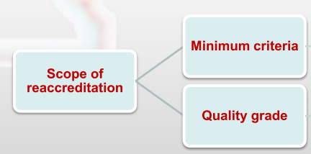
Re-accreditation - Scope

Slide 27
MINIMUM CRITERIA
Prescribed by Ordinance of Accreditation of HE
teacher/student ratio 1:30
space criteria 1 student per 1,25 m²
50/33 percent of study programmes conducted by teachers employed at the institution/own teachers

Slide 28
MINIMUM CRITERIA
For HE institutions registered in the Register of Scientific Organizations
Adopted long-term strategic programme of research in the area in which the teaching activity is performed
Adequate number and qualifications of employed researchers (appointed into scientific position or with an adequate number of scientific papers published)
Proof of adequate facilities and equipment for proposed research
Proof of necessary funds secured for proposed research

Slide 29
QUALITY GRADE
Standards and criteria of quality defined by Accreditation Council of the Agency
1
INSTITUTIONAL MANAGEMENT AND QUALITY ASSURANCE
2
STUDY PROGRAMMES
3
STUDENTS
4
TEACHERS
5
RESEARCH AND PROFESSIONAL ACTIVITY
6
INTERNATIONAL COOPERATION AND MOBILITY
7
RESOURCES: ADMINISTRATION, SPEACE, EQUIPMENT AND FINANCES

Slide 30
QUALITY GRADE
Each standard consists of various criteria
Fulfilment of each criterium must be described with following levels of implementation:
Not implemented
Starting phase of implementation
Partly implemented
Mostly implemented
Fully implemented

Slide 31
CRITERIA/MEETINGS
Meetings are organized with:
1
Management
Meeting with the working group that compiled the Self-Evaluation
2
Metting with representatives of the QA Unit
3
4
Teachers
Students
5
6
Non-teaching staff – tour of the facilities, etc.

Slide 32
1.Institutional Management and Quality Assurance
Focus markers:
Mission
Vision
Systematic strategic planning
Organizational structure
Quality policy and procedures for quality assurance
Mechanisms for monitoring and improving teaching and research quality
Ethical behaviour
Questions addressed to: management, QA department etc.

Slide 33
1.Institutional Management and Quality Assurance
1.5. The institution has a quality policy and connected procedures for quality assurance and enhancement of all its activities.
Quality assurance unit – is it only formal?

Slide 34
Internal Audit
Scope → degree of development and efficiency
of the internal QA system of HEIs
ESG standards part I
Integrated QA system (ISO+ESG)

Slide 35
HEIs QA systems
150 QA units are established at HEIs
126 QA Ordinances
57 QA Manuals
108 students members of QA units
35 representatives from business sector are members of QA units
Enhancement of quality culture

Slide 36
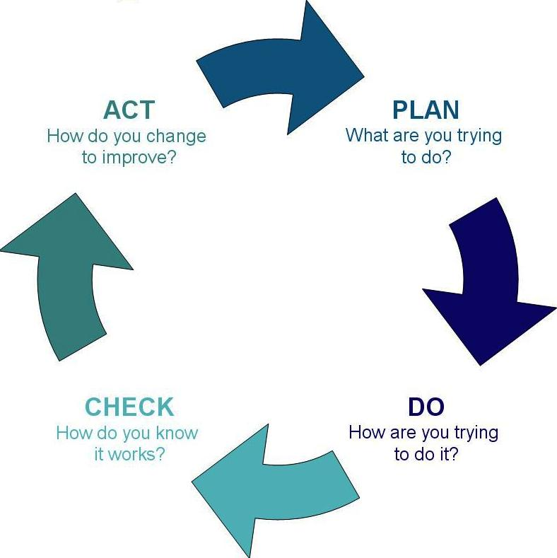

Slide 37
Role of Students in QA system
Internal QA system at HEIs:
Part of governance body at HEI (Senate, Faculty board, SU, …)
Part of advisory body (QA Council, Board, Centre)
Participate in evaluation of QA system/procedures at
Institutional level
Programme level

Slide 38
Role of Students in QA system
External QA system
Part of ASHE Accreditation Council
Part of experts panel (re-accreditation panel, audit panel)

Slide 39
2. Study programmes
Focus markers:
Enrolment quotas – pass rate
Learning outcomes and assessment
Allocation of ECTS credits
Proposing new study programmes and revision of the existing study programmes
Teaching methods
Internship
Questions addressed to: management, heads of departments, teachers, QA department, working group that compiled the self-evaluation etc.

Slide 40
3. Students
Focus markers:
Admission criteria
Mentorship
Assessment
Alumni – track of the employability
Informing the public
Participation in decision-making processes and feedback about the measures implemented on the basis of their suggestions
Questions addressed to: students, teachers, management etc.

Slide 41
4. Teachers
Focus markers:
Number and qualifications of teachers
Encouraging development of teachers
Teaching workload
Questions addressed to: teachers, management etc.

Slide 42
5. Professional and Research Activity
Focus markers:
Priorities and procedures for expert and research activities
Cooperation with industry, businesses, S&ME
Advisory and professional activities
Questions addressed to: teachers-researchers, assistants, management etc.

Slide 43
6. Mobility and International Cooperation
Focus markers:
Mobility of students
Mobility of teachers/researchers
International networks, projects and cooperation
Questions addressed to: management, students, teachers/researchers, representatives of international cooperation office, etc.

Slide 44
7. Resources
Focus markers:
Resources: equipment, classrooms, laboratories etc.
Development of non-teaching staff
Equipment - in accordance with recognized international standards
Library, e-resources
Financial stability and transparency
Questions addressed to: management, non-teaching staff, etc.
Tour of facilities

Slide 45
REPORTS
Report on meeting minimum quantitative criteria (MOZVAG)
Report with quality grade by the expert panel
Accreditation Council

Slide 46
Re-accreditation-outcomes
ASHE makes recommendation to the minister of science, education and sports to:
Issue a letter of expectation up to 3 years (can result in denial of enrolment)
Issue accreditation (for institutions and/or programmes)
Revoke the licence (for institutions and/or programmes)
After expiry:
Issuing the licence
After expiry:
Revoking the licence

Slide 47
OUTCOMES IN PREVIOUS RE-ACCREDITATIONS
2010/2012 - Outcomes
Accreditation granted to 30 HEIs
Letter of expectation issued to 16 HEIs and 5 study programmes
Accreditation recommendation to revoke the licence for 4 HEIs/ appeal procedure underway
Revoke licence to 11 dislocated study programmes

Slide 48
Strengths
ASHE is a member of ENQA and EQAR
External quality assurance procedures in line with the ESG, as well as European and international best practices
Public call for experts (peer reviews)
Foreign reviewers in the panels
Business representatives and students included in the Management Board, Accreditation Council, and review panels
NGO representative member of the Accreditation Council
Accreditation reports and decisions are public

Slide 49
Strengths
Fair and equitable treatment of all stakeholders (public, private, new or traditional HEIs)
Involvement of all stakeholders in implementing changes and carrying out activities
Public discussions with all stakeholders
Public forum – ASHE website
ASHE documents are public (standards, criteria & procedures)
The Ministry clearly committed to independence of the national agency

Slide 50
Strengths
Surveys
Confidentiality Statement – ASHE staff
Confidentiality and Conflict of Interest Statement (everybody participating in external QA procedures)
Accreditation Council Ethical Code
No gifts from HEIs, no paid lunches or dinners from HEIs (members of peer-reviews) – written procedure
ASHE annual report is public

Slide 51
Challenges and Future
Further development of external QA procedures in line with the implementation of National Qualification Framework
Shift from "inputs" to "outputs" /more focus on learning outcomes and employment of graduates
Thematic reviews of "burning issues" in Croatian HE: doctoral education, learning outcomes…
Support to evidence-based policy making: focus on data collection

Slide 52
Challenges and Future
Help our HEIs to enhance their position in EHEA and worldwide (mobility, cooperation with business)
Further support to development of quality culture: workshops, reports…
Strengthen regional and international cooperation

Slide 53
Thank you

Slide 54
Thank you for your attention!
https://www.azvo.hr/index.php/en

